Slide 1
Getting Hooked with Angular

Slide 2
Welcome to Day 1 of Angular!

Slide 3
Remember...
This is not meant to be easy. Angular is complex and it will take time and PRACTICE to get all of these concepts down. But you WILL get it!
Now that you know JavaScript, HTML/CSS, and how to deal with frameworks, it’s time to learn something that will make your lives as developers much more enjoyable.

Slide 4

What you’ll need:
Node.js version 8.x or 10.x
Npm install -g angular/cli
The patience and determination you have all shown so far

Slide 5
Today’s plan

Slide 6
Our First 75...
This Angular slideshow
Instructor Demo and Student Activity 1
15 mins
15 mins
30 mins
15 mins
Introduction to the Angular CLI
Go over Activity 1.

Slide 7
Before we move forward, let’s look back...

Slide 8
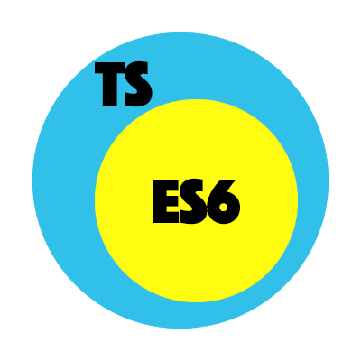
Talk with your neighbor
(5 mins)
What are classes and how are they different from constructor functions?
What are the main differences between TypeScript and JavaScript?
How do you declare a type in TypeScript?

Slide 9
Possible Answers
Classes are syntactic sugar for constructor functions. They make it easier to read and write “class-like” behaviors in JavaScript (and TypeScript).
TypeScript has strict typing and includes *almost* all of the latest features of ES*currentyear*
With a colon after the variable declaration. Like this:

Slide 10
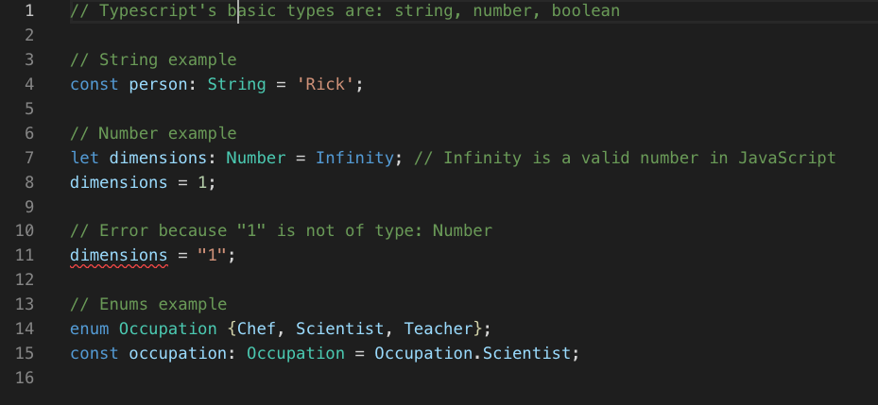
We use TypeScript in Angular because it will make our lives easier as developers.

Slide 11
So what IS Angular?

Slide 12
To put it simply...
Angular is a component-based, open-source framework developed by Google for JavaScript (specifically TypeScript) web applications.
Angular is a framework developed with adaptivity in mind, allowing you to reuse a lot of the same code for web, mobile web, native mobile, and native desktop environments.
Even simpler, it’s the skeleton to your web application. (With some of the organs included!)

Slide 13

We’re not just dealin’ with libraries anymore...
It’s framework time

Slide 14

What’s the difference?
Libraries
Frameworks
You (your code) call libraries.
Essentially just a bunch of functions and classes.
You can use several in one project, bringing them in at any point.
Frameworks call you (your code).
Much more abstract.
Architectural decision that must be made early on. You can’t easily add frameworks in to existing logic.
Frameworks follow the “Hollywood Principle”:
“Don’t call us, we’ll call you.”

Slide 15

Making It MODULAR
Think Legos...

Slide 16
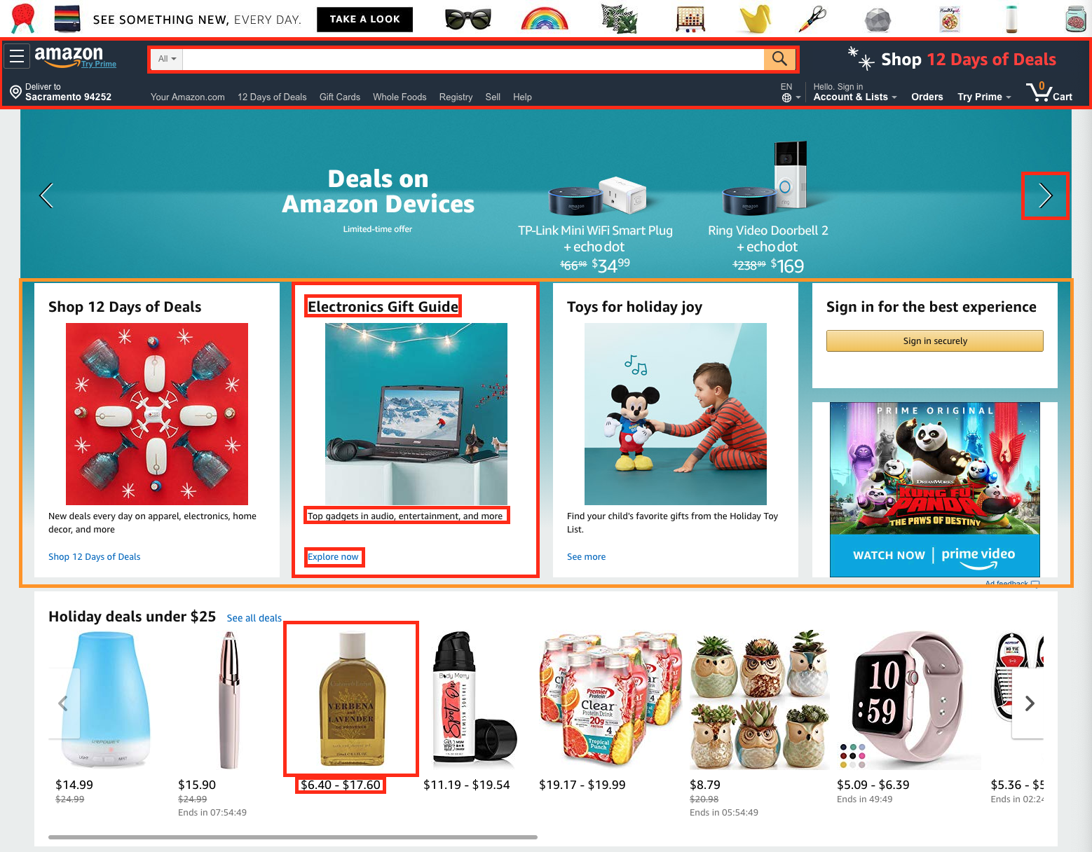
Components are everywhere!
Whether it’s text, images, buttons, sections or entire pages…
Every piece in a large website can be broken down into smaller reusable pieces.

Slide 17
Components make things:
Easier to test
Easier to maintain
Easier to read
Easy to reuse, therefore easier to scale
Noticing a trend here?

Slide 18
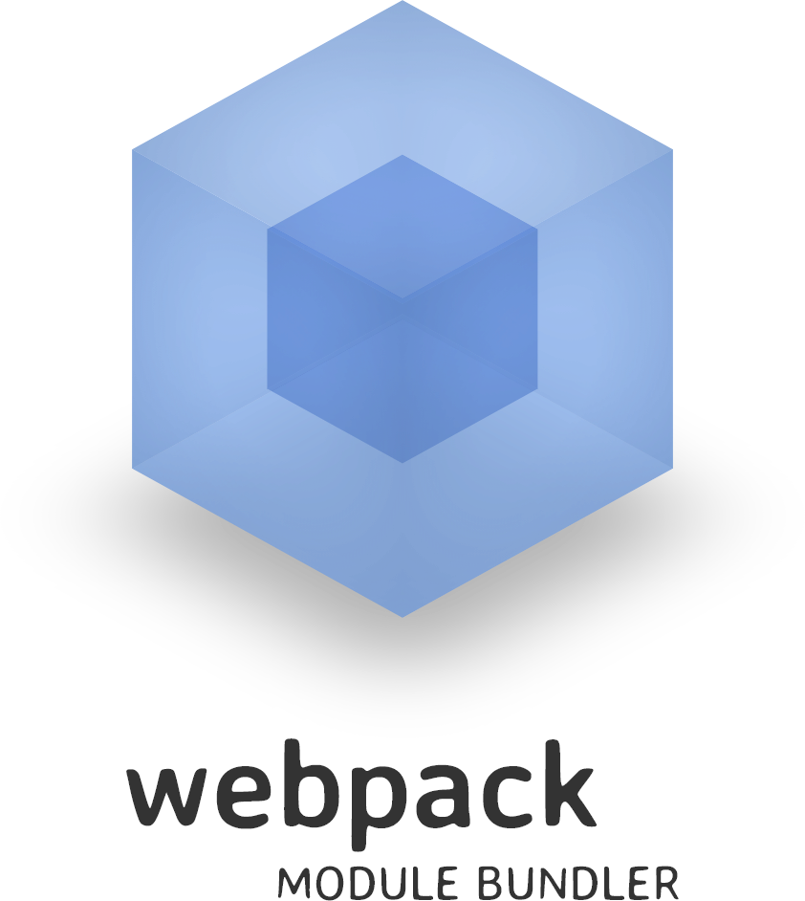
This is all possible because of the webpack module bundler under the hood of the Angular CLI
Webpack recursively builds a dependency graph and bundles our web applications up into bite-sized pieces. This makes it very easy to keep everything modular and easy to modify.
Hooray for easy!

Slide 19
So how’s this different from jQuery?
jQuery
Angular
jQuery is a library for DOM manipulation.
Data binds directly to the UI (DOM) and flows unidirectionally.
jQuery is easy to learn, but only covers one piece of what makes a web application.
Angular is a framework complete with DOM manipulation, routing, form validation, and much much more.
Data binding is bidirectional, meaning if the view changes, so does the model (JavaScript) and vice versa.
Angular is more difficult to learn, but includes all of the pieces in the frontend of an application.

Slide 20

Pros and Cons of Angular
Pros
Cons
Two-way data binding. Angular was created with MVC in mind.
A component-based architecture makes things more readable, reusable, and unit-test friendly.
Built in TypeScript support for a more scalable and cleaner code solution than JavaScript, especially for enterprises.
Complexity. Angular is a framework containing many libraries, and a defined way of structuring applications.
AngularJS and Angular 2/4/6 are vastly different, often making it more difficult to find answers from the community.
* There are many more pros, but they are considered features of Angular’s built-in libraries.

Slide 21

Which automates the build process and makes adding various components, services, and more a piece of cake!
Let’s not forget about the CLI

Slide 22
This is all so cool!
But it kinda seems like overkill...

Slide 23
Well at first glance it does seem like overkill...
• But remember that while Angular is preconfigured with everything you need, (routing, testing, animation, etc.) you don’t have to utilize every feature of the framework.
• Angular isn’t built for two-page applications (although the CLI makes it pretty easy to spin them up). Think BIG!!!
• Of course there are some projects that don’t warrant use of a full-blown framework like Angular, and you will have to use your best judgment on when it’s best to stick to something simple. (An example could be a simple HTML page with little-to-no interactivity.)

Slide 24

Alright let’s get started!!

